Slide 1
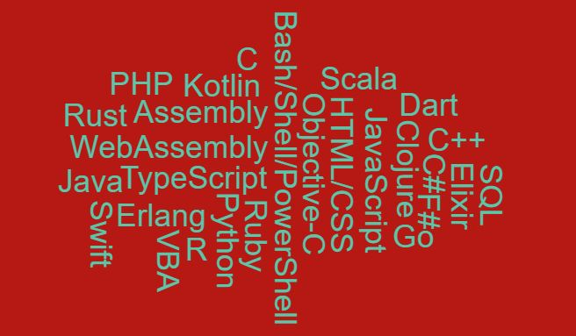






Developer Survey Analysis 2019
D Grigaut
18th November 2020

Slide 2


OUTLINE
Executive Summary
Introduction
Methodology
Results
Visualization – Charts
Dashboard
Discussion
Findings & Implications
Conclusion
Appendix

Slide 3
EXECUTIVE SUMMARY
JavaScript comes in top position as the current langue used and as the desired language to learn.
MySQL comes in top position as the most popular database currently used.
MongoDB that’s is in 5th currently used DB position takes the 2nd position as the DB desired to learn.
93% of the developers who responded to the survey are men.
Most developers who responded to the survey are between age 20 and 30.
Most of the respondents are from the USA

Slide 4
INTRODUCTION
A report with information targeted at those who are currently working in the field or who would like to join the field of developers.
An insight to current and future trends in the field.
Comparison of programming languages that are currently used and responders would like to learn for the futures.
Comparison of databases that are currently used and responders would like to learn for the futures.
The Role of Gender amongst developers. Is there a correlation between gender and working hours? What does the average salary look like for the 2 groups?
Looking at the role age plays in the field. Is there a correlation between age and working hours? What about the pay?
Where do most developers come from?

Slide 5
METHODOLOGY
We used Stackoverflow’s developer’s survey open data for our analysis.
The data set contained 11552 responses. After cleaning and removing duplicates, we had 11398 responses that we used for our analysis.
We had responders from 135 different countries.
We cleaned the age field, with the assumption that the retirement age is 65 in most countries and kept responses that were below 65.
We used the IQR to detect the outlier fences to cleaned the work hours per week field.
We saw that there we many different options given for the gender field but filtered the field to keep the responses: Man and Women.
We used EDA to get visuals and more insight to our data.

Slide 6
RESULTS
26% of our responders identified JavaScript as the most popular language today and 25% identified it as a language that they would like to learn for the future.
The highest paid programing languages are Swift and Python where the programmers earn $130,801 & $114,383 respectively.
At 27%, MySQL is currently the most popular database. 24% responded that they would like to learn PostgreSQL in the future. At 20%, MongoDB was identified as a database that respondents would like to learn in the futures. MongoDB’s current popularity is at only 15%
Most of our responders are male (93%) and most common age group is between age 20 and 30. We also saw that men’s average annual salary is 13% higher than that of women. The number of hours spent working or reviewing code is also significantly lower amongst women than in men. Strong correlation between age and number of hours working or reviewing code.
43.7% of the responders identified themselves as full stack developers and 54% of hold a Bachelor’s degree.
The highest percentage for number of years of coding epxerience is 28% for 6 years.

Slide 7
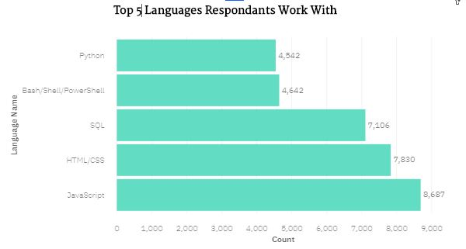
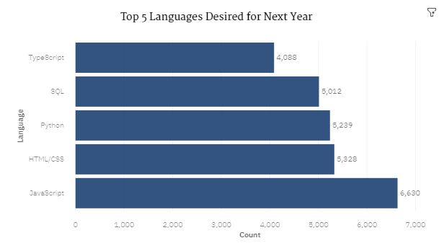
PROGRAMMING LANGUAGE TRENDS
Current Year
Next Year

Slide 8
PROGRAMMING LANGUAGE TRENDS - FINDINGS & IMPLICATIONS
Findings
JavaScript the most popular language currently.
JavaScript is also the most popular language that respondents would like to learn in the future.
Implications
Looking at the 2 bar graphs for the top 5 most popular languages JavaScript, HTML, Python, SQL are in high demand for now and for the future.
Python seems to have the highest rise in demand as the language respondents would like to learn for the future.

Slide 9
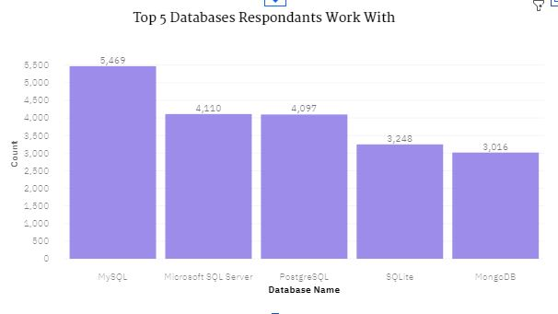
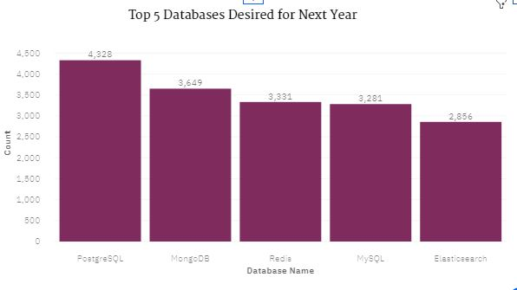
DATABASE TRENDS
Current Year
Next Year

Slide 10
DATABASE TRENDS - FINDINGS & IMPLICATIONS
Findings
The most popular databases currently are MySQL and MS SQL Server.
The least popular database in terms of current usage is MongoDB
For future preference, the most popular database was identified as PostgreSQL.
Implications
Currently the most popular databases use structured data.
There is a high demand for future for databases that use unstructured data.
This can be seen in the rise in popularity in databases such as MongoDB, Elasticsearch and Redis.

Slide 11

DASHBOARD
Please Click to see Dashboard

Slide 12
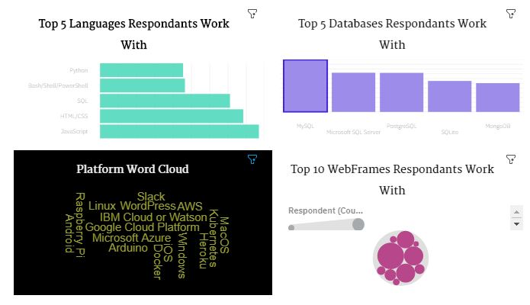
Current Technology Usage

Slide 13
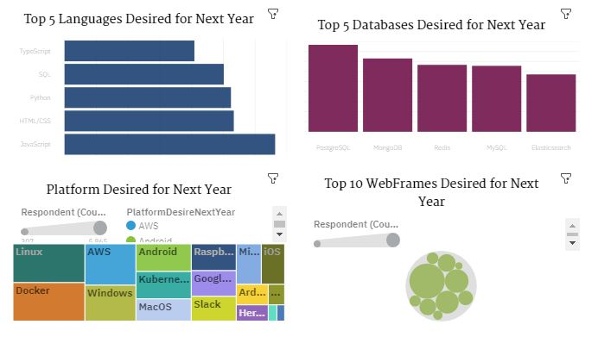
Future Technology Usage

Slide 14
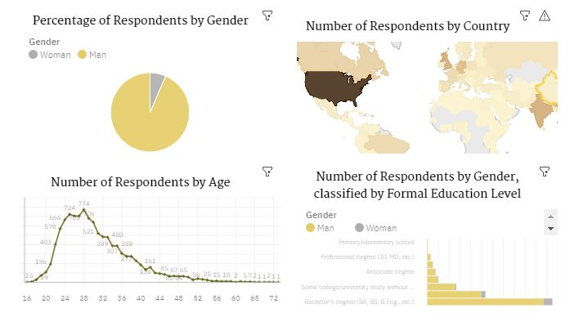
Demographic Analysis

Slide 15
DISCUSSION
From our demographic analysis, we can see that most of our responders are in the USA and then in India. Surprisingly very few in Europe. Is this the reality or did we not get responses from European developers, given that the survey was in English and in most European countries, English isn’t the primary working language?
Given that most of the developers are between 20 and 30 years old, we can, can we conclude that this a field where workers are young?
Is there such a big difference in Gender in the field?
Do women really spend less hours working and reviewing code than men? Does this explain the difference in pay between the 2 genders?

Slide 16
OVERALL FINDINGS & IMPLICATIONS
JavaScript is currently the most popular language
93% of the respondents were Men
MySQL is currently the most popular database
44% are full stack developers
Implications
While JavaScript is the current favorite, Python seems to be rising in popularity as a language developers would like to learn for the future.
While 93% of the respondents were men and earn 13% higher annual salary than women, they also contribute to the field in a higher number of hours than women.
An in increase in demand for unstructured databases such as MongoDB and Elasticsearch.

Slide 17
CONCLUSION
JavaScript is the most popular languages amongst developers and required skills for jobs. Python is not far behind and seems to be rising in popularity.
There is a strong demand for the future for non relational databases.
The developers are between 20 and 30 and for this age group there is a strong positive correlation between age and working hours per week.
Women spend less hours working and reviewing code per week and earn less than men.
Percentage of women in the field are also significantly lower than men.

Slide 18
APPENDIX
Github job postings
Type of developers and level of education.
The coding experience
What role does age play in this field?
Popular languages Vs average salary
What role does gender play in this field?

Slide 19
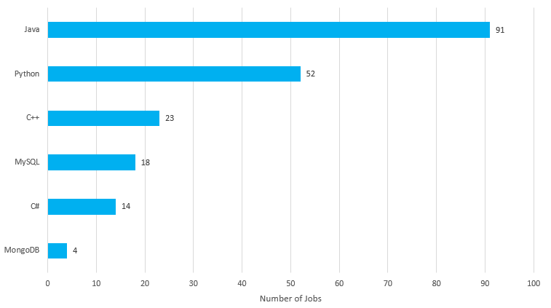
GITHUB JOB POSTINGS
According to Github job postings the most sought after skills are Java and Python.

Slide 20
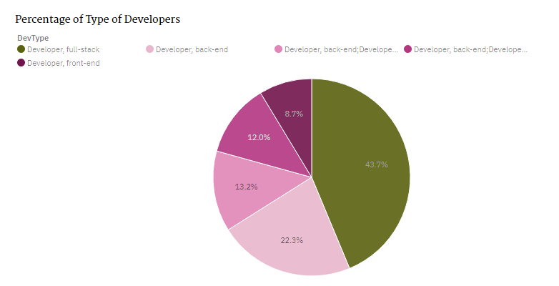
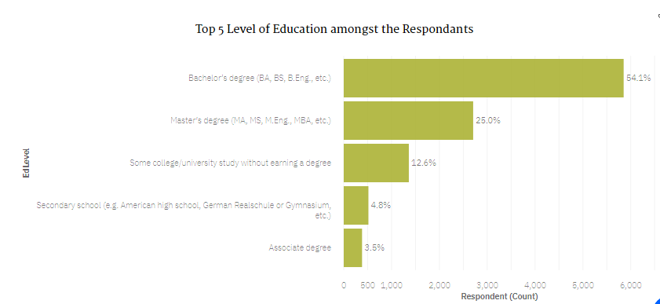
TYPE OF DEVELOPERS AND LEVEL OF EDUCATION
At 43.7% the highest percentage of developers are Full-Stack Developers.
More than half (54.1%) of the respondents had a Bachelor’s degree.

Slide 21
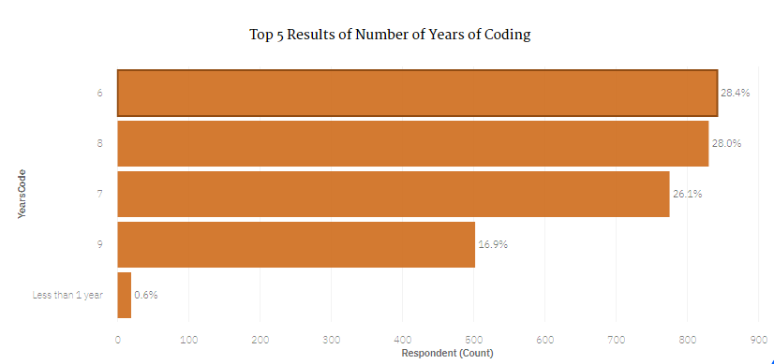
THE CODING EXPERIENCE
The highest percentage for number of years of coding epxerience is 28% for 6 years.
Only 0.6% of respondents are are beginers with less than 1 years experience.

Slide 22
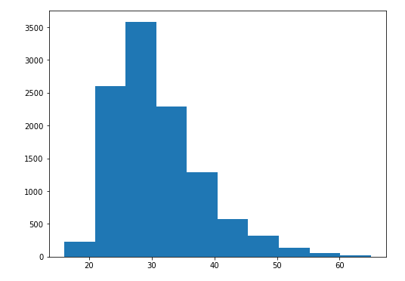
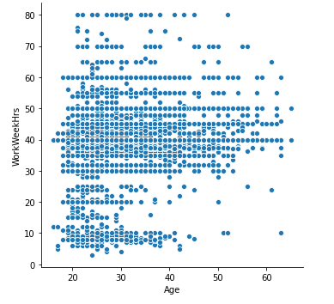
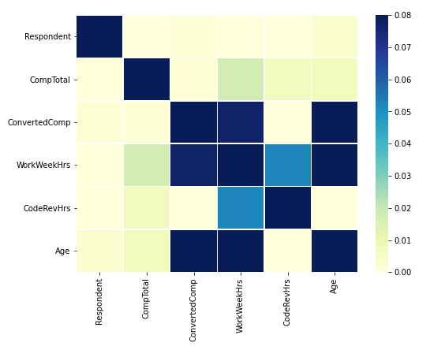
WHAT ROLE DOES AGE PLAY IN THIS FIELD?
Histogram shows that the highest number of developers are between the age of 20 and 30
Scatterplot shows that that there is a strong correlation between age and number of working hours.
Heatmap confirms that there is a strong correlation between age and working hours and also annual salary.

Slide 23
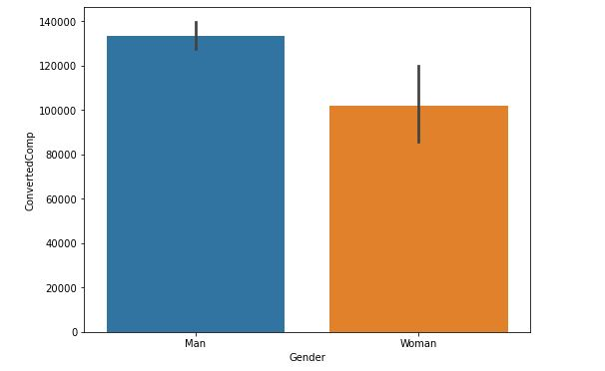
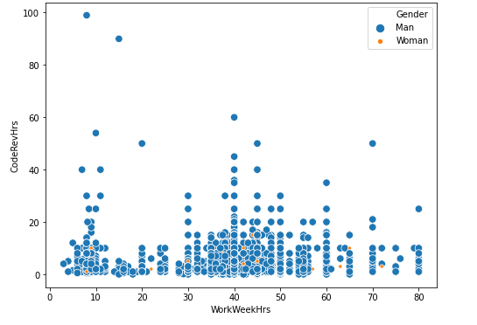
WHAT ROLE DOES GENDER PLAY IN THIS FIELD?
Average Annual Salary for men in the field is 13% higher than that of women.
According to this Bubble chart, women spend far less hours working or reviewing code. Maybe that explains the difference is salary?

Slide 24
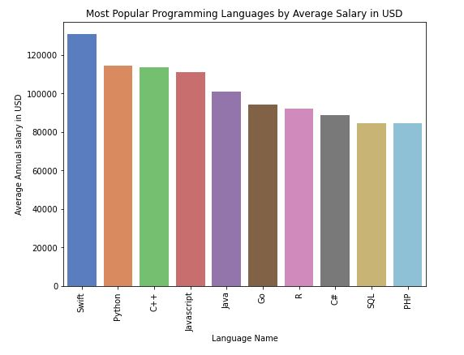
POPULAR LANGUAGES Vs AVERAGE SALARY
The highest paid programing languages are Swift and Python where the programmers earn $130,801 & $114,383 respectively.
The least paid programing languages are SQL and PHP where the programmers earn $84,793 & $84,727 respectively.

